Slide 1
Edale Peak Centre 2023 Monday 17th April – Wednesday 19th April Wednesday 19th April – Friday 21st April
www.peakcentre.org.uk

Slide 2
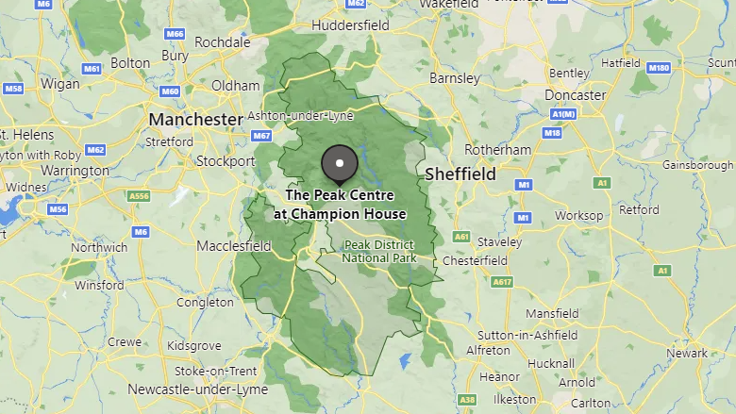

Slide 4
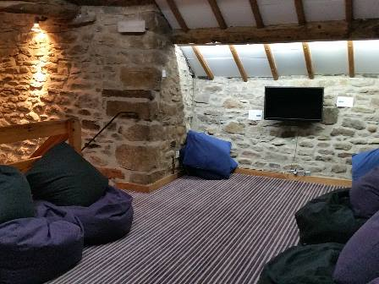
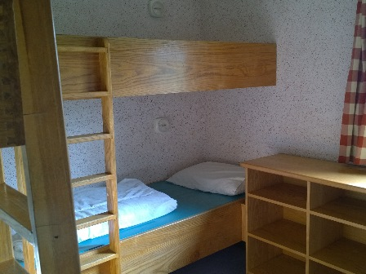
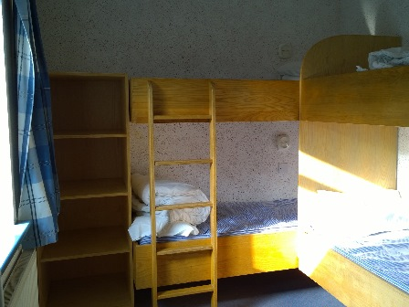

Slide 5
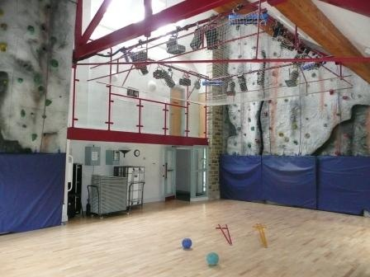

Slide 6
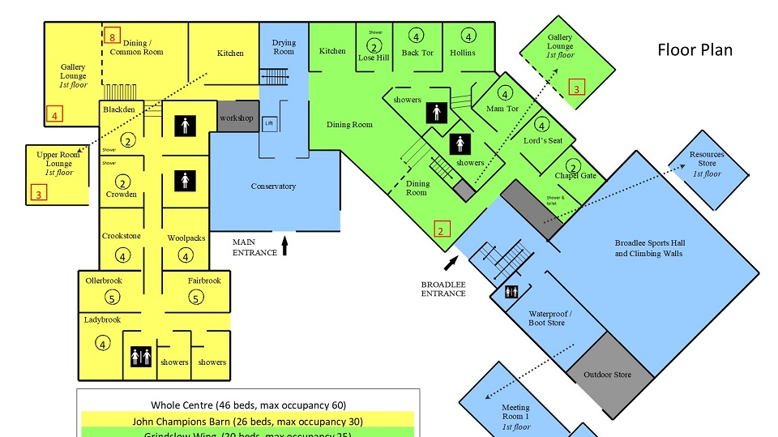

Slide 7
Day 1
Arrive at school as usual.
Leave suitcases and luggage in the Old Hall
Leave for Edale later in the morning.
Arrive at Peak Centre around Midday.
Settle into rooms and have safety talk with PC staff including fire drills, making beds, unpacking clothes and exploring the PC.
Start activities

Slide 8
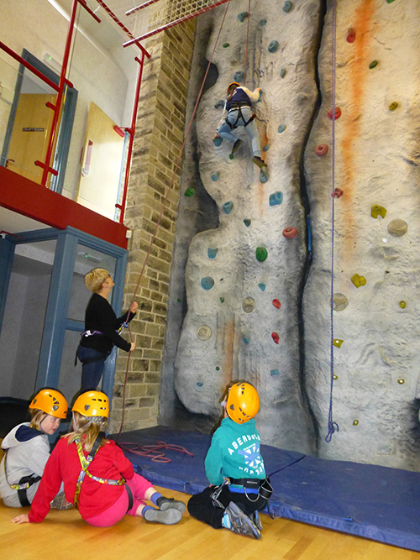

Slide 9
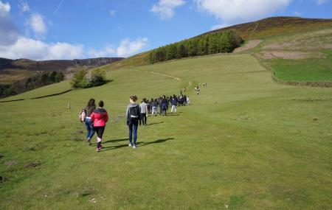
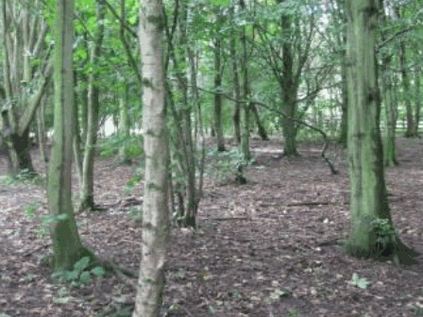
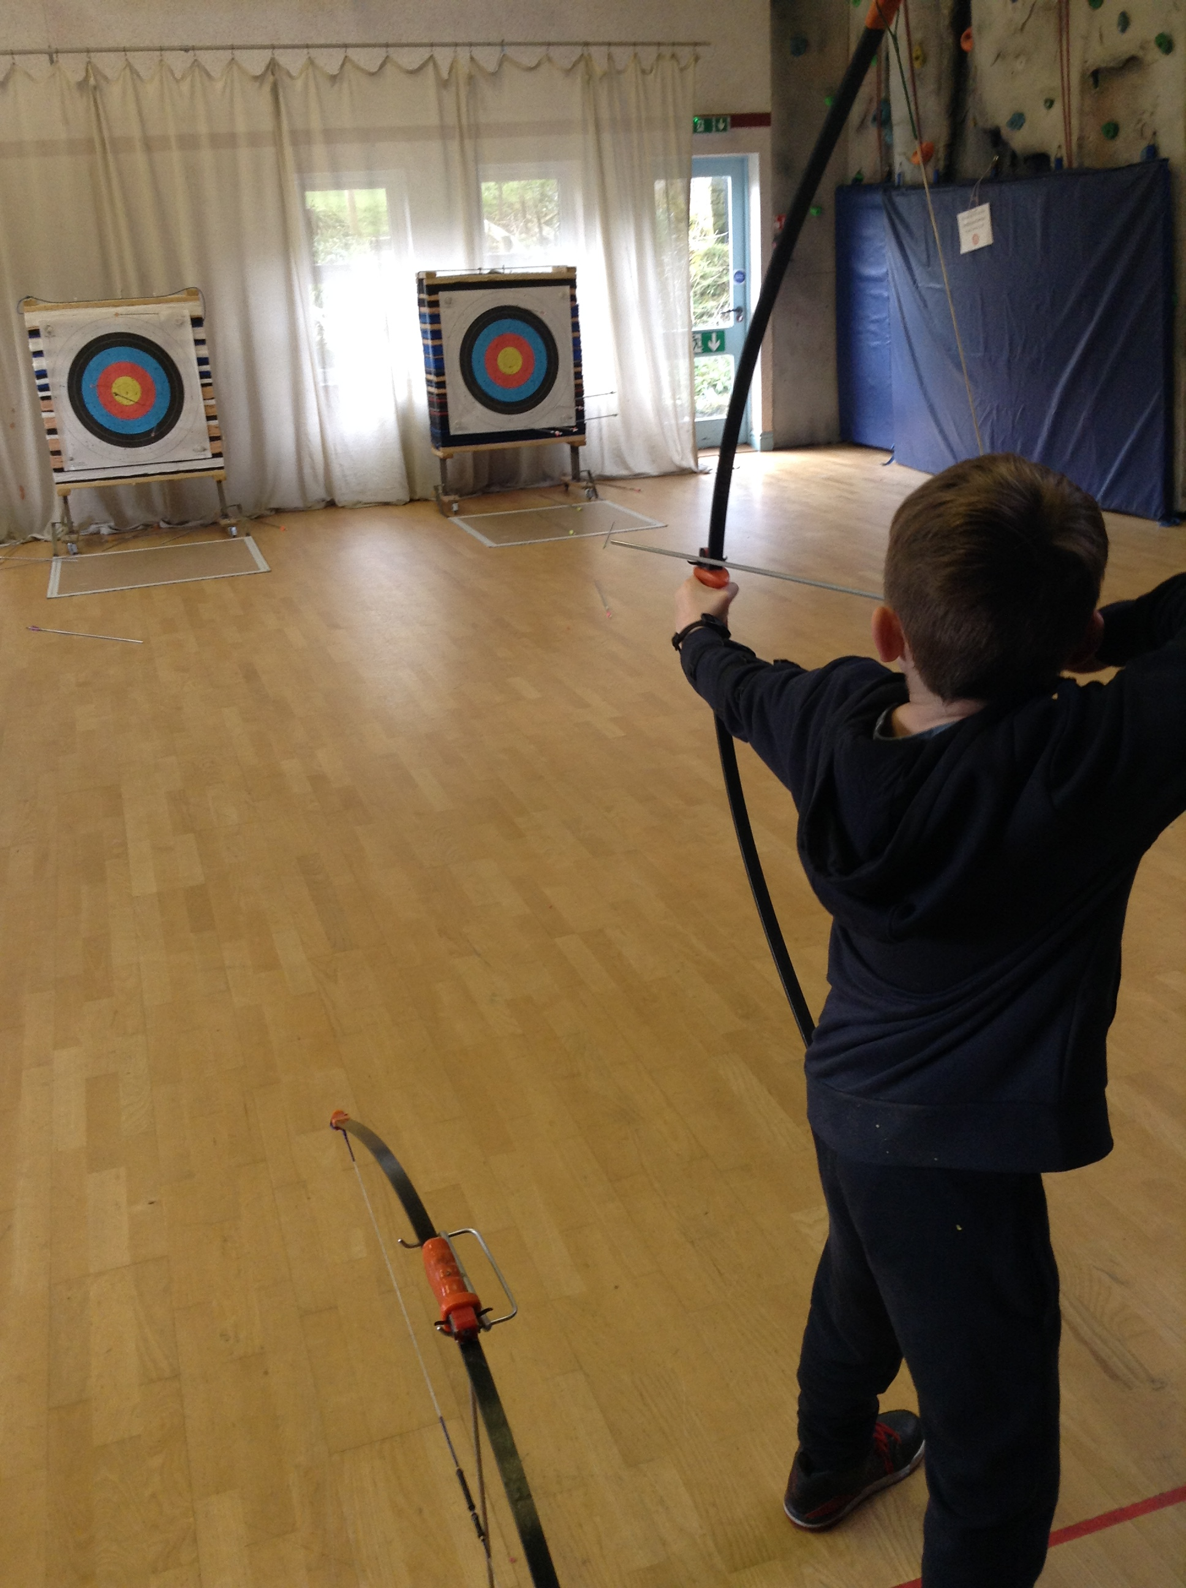

Slide 10
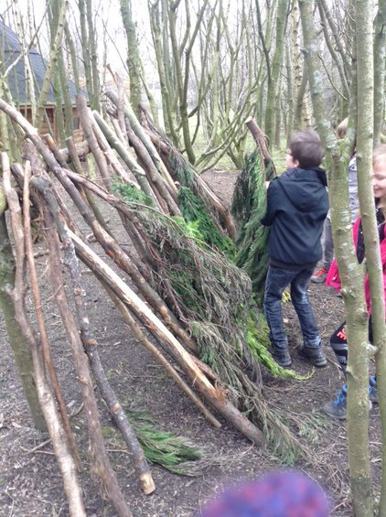
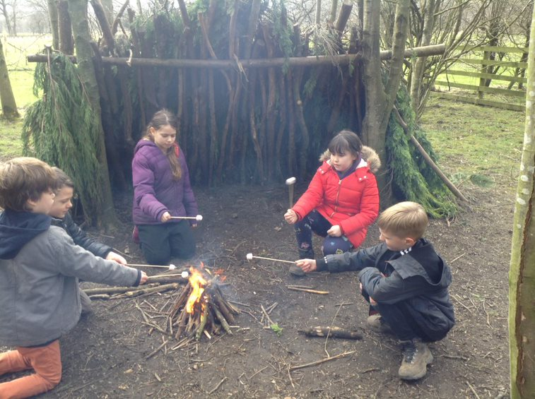
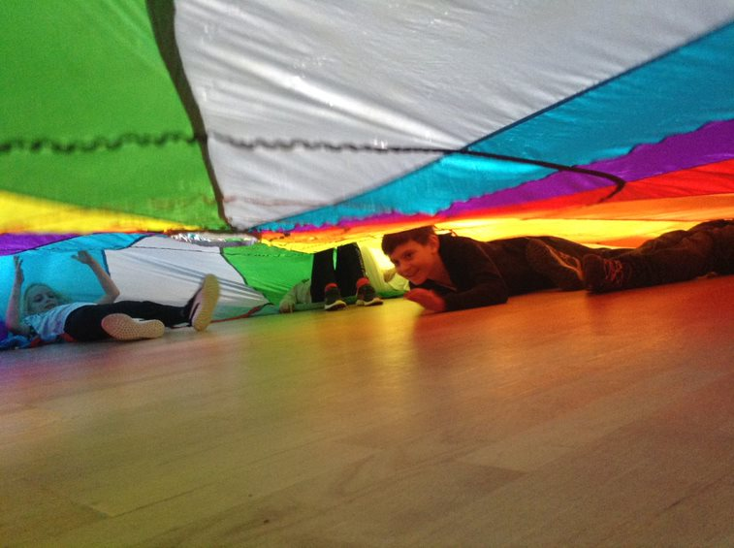

Slide 11
Day 2
Wake up at the Peak Centre.
We will be having Breakfast, lunch and tea as a group at the Peak Centre.
Throughout the day the children will be split up into groups taking part in activities such as archery, orienteering, climbing wall, nightline etc.

Slide 12
Day 3
Wake up at Peak Centre.
We assemble in the dining room and have breakfast as a group.
The children will be split into 3 groups again and will be taking part in their final activity whilst the other groups tidy up – swap over.
After the morning activities we will eat as a group before loading our luggage back onto the bus and setting off back for school.
We are aiming to arrive back at school in time for the end of the school day. Your children can be picked up on the playground at the usual time. We will keep you updated on our progress back to school via Twitter or Text Message.

Slide 13
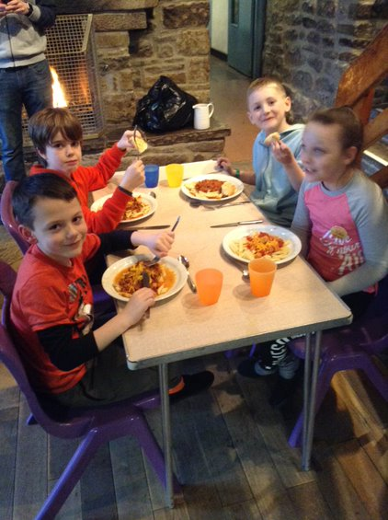
Meals
Food is freshly prepared for us.
Eat in tables encouraging good table manners and conversation.
Breakfast – cereals and toast
Lunch – sandwiches, fruit, crisps, biscuit
Dinner – cooked meal and pudding
Plenty of drinks throughout the day.
Encourage trying things but there's always alternatives if needed.

Slide 14
Kit List
In a small rucksack
Refillable water bottle.
Inhaler (if needed). Any other medication must be handed straight to class teacher.
NO mobile phones, tablets or other electronic games.
Small game, notepad or book
Packed lunch for the first day in a disposable bag.

Slide 15
Kit List
In a larger rucksack or holdall
Coat suitable for outdoor activities, waterproof trousers and walking books are provided by the centre if necessary.
Trainers suitable for outdoor (possibly muddy) activities.
Woolly or sun hat depending on the weather as it could be either really chilly or very warm!
Ankle socks not trainer socks.
Enough comfortable clothes for the stay, allowing for an extra outfit in case of mud/rain! Things like jeans, joggers, leggings, long sleeved tops, sweatshirts, fleeces
Towel and toiletries.
Pyjamas
Indoor shoes, PE trainers are perfect – not slippers as they will be worn for indoor activities
Anything you need to sleep with like teddy or book!!!
NO sweets, chocolate, drinks
PLEASE ENSURE YOUR CHILD’S NAME IS ON EVERYTHING!

Slide 16
Things to consider
Size of luggage – The children have to be able to carry their own luggage from the car park to the Peak Centre.
Medication – Any medication your child requires needs to be highlighted on the medical forms, please update us if anything changes between filling in the form and the day we leave. If you are sending medication to Edale it needs to be given to a member of staff on the morning of the trip, labelled clearly with the child’s name and dosage amounts.

Slide 17
Groups
Children will be in a dining room group, a bedroom group and 2 different activity group so will get a chance to be with all their classmates.
We will choose these based on our knowledge of the children’s friendships and behaviour.
We will not share groups until we arrive in Edale.

Slide 18
Before we go
Children will not have lights on at night, the doors are fire doors so they cannot be propped open. Between now and when we go, please get your child used to sleeping without a light, music playing or a screen in the room gradually.
Children will be expected to make their own beds – with help – if they could practice that would be brilliant.
Same with shoelaces!

Slide 19
Paperwork
We will send home forms as soon as we have gauged numbers.
It must be fully filled in or we will have to return it.
If there are any changes between now and going to Edale please inform us and if need be complete another medical form or it can be amended.

Slide 20
Contact
We will endeavour to text and Tweet as often as possible during the trip but the wifi is a little patchy
Not all groups will have an iPad for photos all the time so don’t panic if you don’t see your child in a photo – it doesn’t mean we’ve lost them!
Miss West, Miss Gavagan and Mr Ord will be in have direct contact with Mrs Hallsworth and/or Mr Hetherington whenever needed.

Slide 21
Any questions
Please either see your child’s class teacher at school or email
year3-4department@scargill.derbyshire.sch.uk

