Slide 1
Year 1 Parent Information Event
Monday 14th November 2022

Slide 2
What is the meeting for?
We realised that a number of things we normally share with parents haven’t yet been shared.
The parent questionnaire highlighted some areas you would like to know more about.

Slide 3
School Day
Year 1 follow the National Curriculum. This is broken in to subjects, all of which have expectations for the end of KS1, therefore children have two years to achieve the expectations.
All classes have the same experiences as we plan for the whole KS.
The morning is usually broken down into English, break, phonics, Maths and handwriting.
The afternoons involve reading groups, and two subject areas such as Science, PE, computing, Design and Technology, PSHE, Religions and Worldviews, History etc…

Slide 4
School Day continued…
As a Church School we also have collective worship each morning. Mondays are whole school, Tuesdays are in class, Wednesdays KS worship (with Reception joining us soon), Thursday- praise worship and Friday Celebration Worship.
Within the celebration worship all classes celebrate two Scargill Stars and a Writer of the Week. The mid-day supervisors also celebrate children across school and decide who will be on ‘top table’. The Maths lead also celebrates the top three Numbot children.
To support children’s independence and develop working as a team the children have different responsibilities in class.

Slide 5
How does it work in a mixed class?
Year 1 have Maths and phonics taught in their year groups as the Power Maths books are specifically designed for that particular year group. This is the same throughout school.
Year 1 are taught phonics, following the Little Wandle Phonics scheme. 30 minutes each day.
Currently handwriting also taught separately.
The rest of the curriculum is completely mixed. Over two years the children will have covered all the curriculum content. All subject leads have completed overviews for their subjects, which you can find on our school website.
Teachers use quality first teaching to ensure children are supported in different ways, this includes using word mats, adapting lesson plans, use of vocabulary, use of peer support. The list is endless!

Slide 6
Reading and Phonics
We follow the Little Wandle phonics programme which started in Reception last year. Phonics screening success last year.
The children read to an adult within a group 3 times a week. Each day has a specific purpose- decoding, prosody and comprehension.
Where children have additional needs they will be heard 1:1 more often.
Reading book levels are decided following assessments from the Little Wandle programme, but with adult input.
By the time the books go home, (Friday) children should be reading it fluently. What does this look and sound like?
Reading books and records must be sent in to school daily.

Slide 7
Reading and Phonics
Read-a-rainbow – what is this, why do we do this and how does it work?
Reading for pleasure. This is a book the children can change any day- it is a book to be enjoyed together with family.
Where children need extra phonic support they will work with our dedicated TA team who will send out letters/words on stickers and in a little book for the children to learn to recognise.
Nessy- all year one can use it, once parental consent given.

Slide 8
Homework
This is sent home on a sheet every other Monday. Once completed it must be stuck into your child’s homework book.
The homework book then needs to be handed in to the teacher/ put in the homework box.
Online homework is set in between. Purple Mash is used in the computing lessons each week, so always check the 2do instruction- if it says ‘To be done at school’ it means it is not homework.
What is expected? How much help should your child get? Everyone is different and one size doesn’t fit all.

Slide 9
Handwriting
We use the Nelson handwriting scheme across school.
The aim is to ensure all letters are correctly formed so that by the end of the year children are in a good position to be able to join their letters.
Some children find letter formation/ size of letters more challenging than others- how do we support this?
How can you help at home? Continue the activities shared from the previous year, supporting good writing posture and positioning when completing any writing activities.

Slide 10
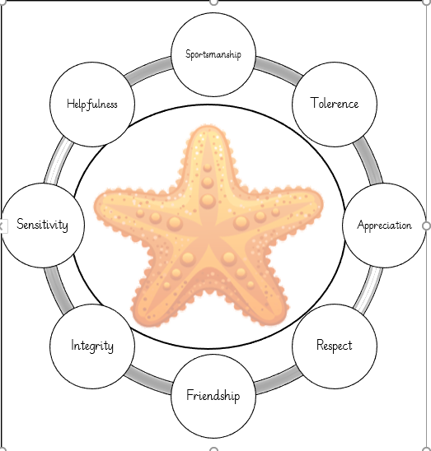
Rewards
Celebration Worship
Read-a-Rainbow
Star of the day
Starfish Values -Sportsmanship, Tolerance, Appreciation, Respect, Friendship, Integrity, Sensitivity and Honesty & Helpfulness
Dojo points
Freedom points

Slide 11
A Few Reminders
PE- earrings should be removed for safety reasons.
Only one stud per ear allowed. No hooped earrings.
Label everything! Just like in Reception, children still find it really difficult to recognise their own clothes after removing them. Labels really help!
Books to go inside your child’s wallet, zipped up to protect these from water damage. Bookbags only- rucksacks are not permitted in school.
If your child is absent from school, contact the office.

Slide 12
Communication
TA meet and greet in the morning
Year 1/2 department email Y1-2@scargill.derbyshire.sch.uk
Website- Y1/2 newsletters, whole school newsletters, twitter, photos, curriculum and so much more! www.scargill.derbyshire.sch.uk
Dojo point notifications
Data sheets Autumn 2, Spring 2 and Summer 2
Parents evening twice a year
Come and see school in action on Thursday morning.

Slide 13
Thank you for coming! Keep an eye out for a questionnaire as a follow up to this information event.

