Slide 1
Lea Green parents meeting
Residential Thursday 25th-Friday 26th May 2023

Slide 2
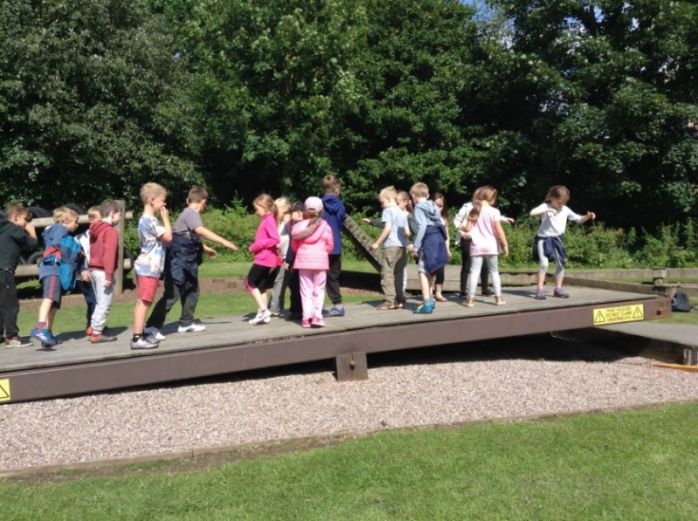
Why a residential?
For the children to develop the following skills:
Independence – away from family for first time?
Self-confidence
Co-operation and teamwork – looking after each other
Trying new things
Develop a sense of adventure
Making memories!
To have lots of fun!

Slide 3
Timings for Thursday
Children will come to school at the usual time, but they will need to wear their clothes and bring their bags ready for Lea Green.
Children depart for Lea Green in the morning so that they will arrive before lunch ready for the fun to begin.
They will need to bring a packed lunch for the Thursday.

Slide 4
Timetable for Thursday and Friday

Slide 5
Timings for Friday
Wake up, get dressed, have breakfast and pack belongings.
Morning activities
Depart Lea Green ready to arrive back in time for home time.
The children will stay in school until the end of the school day and are to be collected at 3.25pm as usual.
In the unlikely event of any delays we will inform you via text message.

Slide 6
Activities
Low ropes – obstacle course
Cave
Buggies
Sports hall and outdoor sports courts also available
Mini dens/Bushcraft – Shelter building, basic survival, toasting marshmallows
Star Ambush – team game ( to tire them out completely for bedtime!)

Slide 7
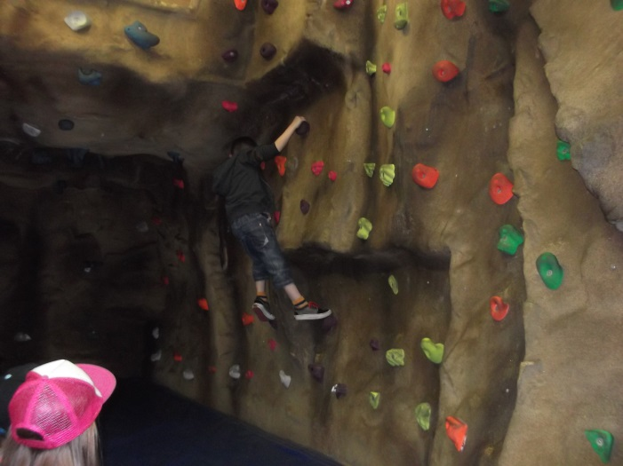
Activities
Cave
Sports Hall

Slide 8
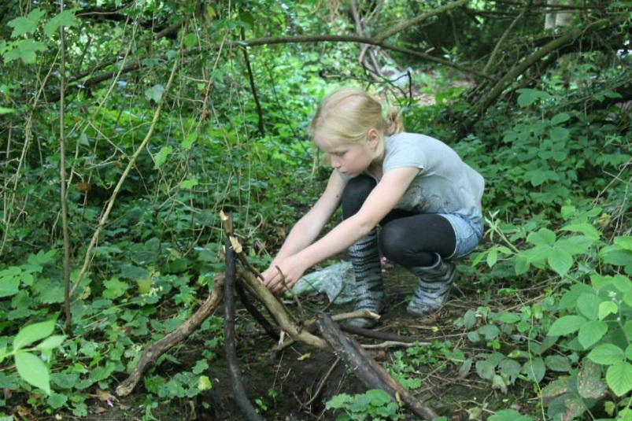
Activities
Mini dens

Slide 9
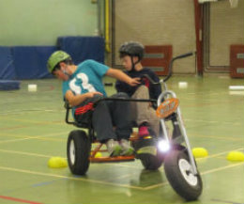
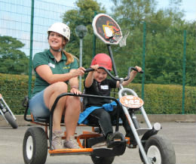
Activities
Buggies

Slide 10
Activities
Low ropes

Slide 11
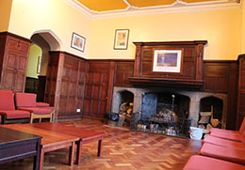
Activities
There will be very little ‘free’ time, however there is a common room downstairs.

Slide 12
Kit list
Waterproof coat/jacket
Outdoor shoes/walking boots
Indoor shoes/trainers
Sunhat/suncream
Old tracksuit bottoms, t-shirt and top (these are likely to get muddy!)
A change of clothes.
Underwear and socks
Pyjamas/ night clothes
Flannel, miniature bodywash/ soap/ wipes and hand towel (hopefully no-one will need a shower!)
Toothbrush and miniature toothpaste.
No earrings please.

Slide 13
Things to Consider when packing
Please pack WITH your child and go through what they have got to wear.
Children will have to carry their own bags upstairs, so please don’t send anything too big or heavy. At the same time, make sure bags have plenty of space in them as children will be re-packing their own bags.
Pack for all kinds of weather!
We will be outdoors for most of the time – please send changes of clothes!
Bin liner for wet/dirty clothes!

Slide 14
Food
Is delicious and plentiful!
There will be a hot evening meal, a cooked breakfast and a picnic lunch.
Breakfast options: cooked breakfast, cereals, toast
Please do not send any other food, sweets, chocolate bars or fizzy drinks
Family style dining.

Slide 15
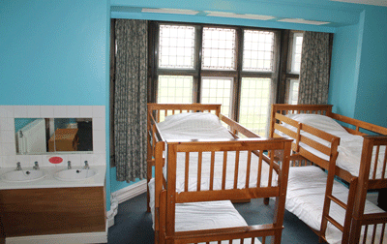
Dormitories
Sleep from 2-10 people
Girls and boys in separate rooms
Each child will choose 1 friend
Children are responsible to keep their room tidy
Toilets close to rooms
Staff rooms close by

Slide 16
Personal belongings
The children will be responsible for looking after their own belongings – please label all clothes/shoes etc.
The children will not need to bring any money.
Please do not send any electrical devices such as tablets, mobile phones, Switch's etc.
Your child may want to bring a book to read or a small teddy. Small torch for night time is also fine.

Slide 17
Peace of mind!
Safety is paramount. Access to the building is via a keypad. Lea Green staff fully trained and insured. One stays on site overnight. Fire drills practised until they are correct.
Children won’t be able to ring you but we will send regular tweets to update you on all the fun activities your children will be involved in.
If your child is ‘Non Tweetable’ but you would like to make an exception for the residential please speak to your child’s class teacher who can get the necessary forms.
We will administer any medicines necessary as long as you have signed allowing us to give prescribed medicines.
In the unlikely event of your child falling ill we will ring you so please keep your phones on.
All children’s needs can and will be catered for. Please come and talk to us if you have anything you are worried about.

Slide 18
What to do next
Form of interest will be text out for you to tick whether your child would like to attend. Please complete this by the end of Friday 27th January 2023.
https://forms.office.com/Pages/ResponsePage.aspx?id=F9OjCDQI6E2eAsKY8Yo97dxklKfWHO9DpeR0rBh0tAtUNVk2MjlEMkZJT0RWUkdWRU5ZVFdOQzY1Ui4u
Once we know we have enough interest to make the trip viable, there will be a pack of information sent home including a consent form/medical details/dietary requirements
All payments and details of deadlines will go on Parentpay

Slide 19
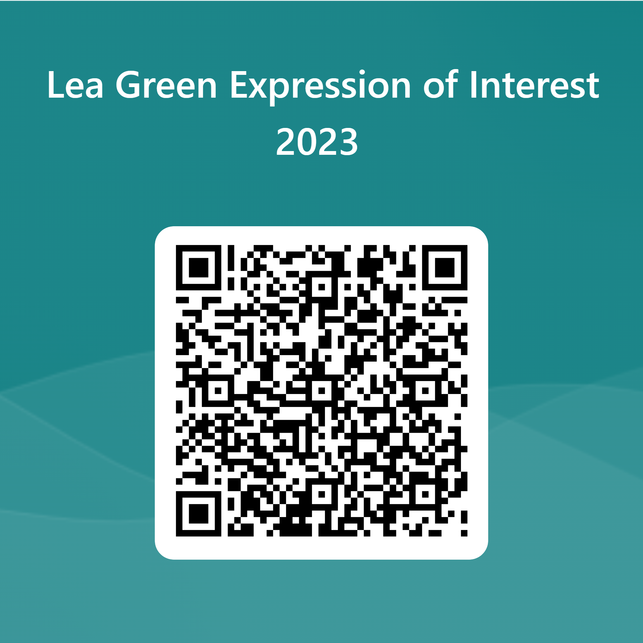
What to do next

